Slide 1

Welcome
Notes:
Topic: Understanding Stress
Time: 30 minutes
Purpose of training evolution: Sailors will recognize and manage physical and mental responses to challenges and threats, harnessing the positive effects of stress while mitigating the negative effects to enhance resilience and performance.
Expected outcome of training evolution: Sailors will learn how to identify stress level, regulate response, and optimize performance in challenging situations.
Safety: Inform Sailors of safety hazards in the training environment. For some topics, Sailors should be informed if there is a designated person to talk to if the Sailor feels compelled to leave the training.
Facilitator Actions:
Display slide.
Greet Sailors.
Introduce yourself and give any background on yourself that might be of interest.
Establish credibility.
Facilitator Instructions:
The slide deck acts as a guide to present a facilitated discussion that may include activities.
Best practice: Use the slide to develop interest in the subject matter. Do not read the slides word for word. The Sailors should be able read the text and understand the messaging presented in the graphics.
Facilitator notes are available for each slide to help the Facilitator deliver the topic.
Best practice: Use the Slide Show view to ensure the Facilitator notes are viewable.
The Facilitator notes are divided into general instructions for Facilitator Actions (mechanics of facilitation) and the Facilitator Content (Inform, Discuss, Perform, and Reference).
Best practice for Inform: Present facts, concepts, and procedures. Depending on the subject matter, these may be written as suggested talking points or scripted material (denoted by quotation marks).
Best practice for Discuss: Conduct large-group question and answer sessions or large-group, Facilitator-led activities. Depending on the subject matter, these may be written as questions with expected answers or scripted activities.
Best practice for Perform: Facilitate small-group, scenario-based or procedural activities. Depending on the subject matter, these may be written with specific actions the Sailors will take or general ways for the Facilitator to monitor the activities. The Facilitator will be provided with expected outcomes to ensure Sailors leave training with correct information.
Best practice for Reference: This is for Facilitator use only.

Slide 2
Warrior Toughness
Introduction
MIND • BODY • SPIRIT
Understanding Stress
Notes:
Facilitator Actions:
Display slide.
Introduce topic.
Let Sailors know that they can leave the discussion if they have to for their own well-being.
Ensure that misinformation is corrected immediately.
Monitor the discussions of the Sailors throughout the training event.
Facilitator Content:
To strengthen Warrior Toughness, Sailors will recognize and manage physical and mental responses to challenges and threats, harnessing the positive effects of stress while mitigating the negative effects to enhance resilience and performance. Sailors will learn how to identify stress level, regulate response, and optimize performance in challenging situations.

Slide 3
Learning Objective
Manage the physical and mental responses to challenges and threats.
Notes:
Facilitator Actions:
Display slide.
Neither Sailors nor Facilitator should read the objective out loud.
Facilitator Content: N/A

Slide 4
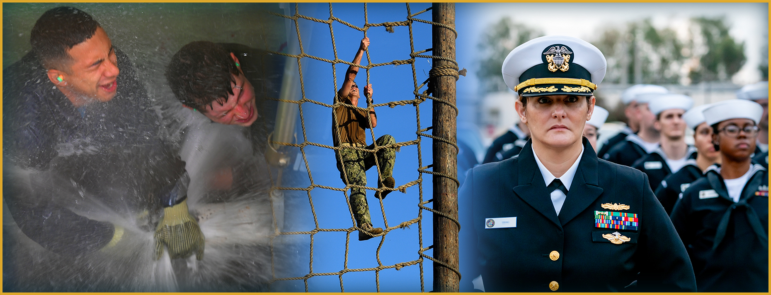
Understanding Stress
What is the difference between stress and a stressor?
Notes:
Facilitator Actions:
Display slide.
Discuss how graphic relates to topic.
Monitor the discussions of the Sailors.
Facilitator Content:
Discuss:
What is the difference between stress and a stressor?
What stresses you out?
How do you know when you are stressed?
What are some examples of stress?
Inform:
Stress happens to us. Stress is our body's response to a stressor. People react differently to stressors, and not everyone has the same response. Stress is a state of mental or emotional strain, or tension, resulting from demanding circumstances. Stress is associated with an individual’s perception of their ability to handle adverse or demanding circumstances. Stress can have a positive and negative effect on your Mind, Body, Spirit, and social domains.
Stressors are events, experiences, or environmental conditions that cause stress in an individual. Events or experiences are perceived as threats or challenges to individuals and can be physical or psychological.
Discuss:
What are some examples of stressors? Answers may include the following:
Basic training
Field exercises
Missions or deployments
Training
Inspections
Work
Relationships
School
Can you think of other examples of military demands?
Inform:
Common environmental conditions include the following:
Geographic location
Weather
Smell
Noise
Toxins
Disease
Air pollution
Traffic
Catastrophic events

Slide 5
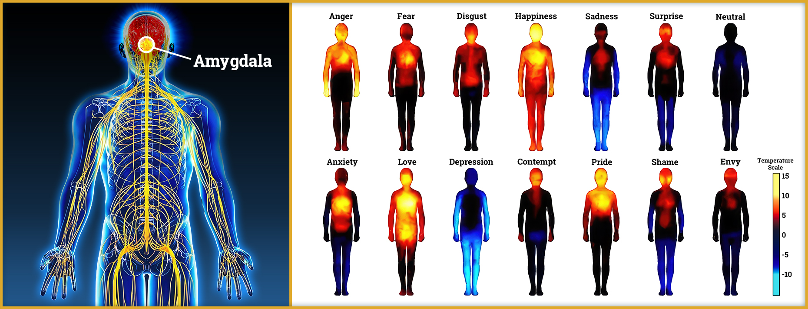
The Mind-Body Connection
Notes:
Facilitator Actions:
Display slide.
Discuss how graphics relate to topic.
Monitor the discussions of the Sailors.
Facilitator Content:
Inform:
The mind and body are deeply connected. What happens in our brain can directly impact our physical state. For instance, different emotions trigger distinct physical responses, which can be detected throughout the body.
The amygdala is the part of our brain responsible for triggering the fight, flight, or freeze response during stress, which helps us react quickly to perceived threats.
Discuss:
What does the amygdala do in a stressful situation?
Inform:
When a stressful situation arises, the amygdala, which is the part of the brain that processes emotions, takes over control, bypassing the frontal lobes. The frontal lobes are the part of the brain responsible for rational thinking and decision-making.
With the frontal lobes bypassed, the amygdala activates the fight-or-flight response. As a result, you may find it difficult to think clearly, make rational decisions, or control your actions.
The stress response is an automatic physiological reaction that occurs in response to a perceived threat, preparing the mind and body to deal with the danger.
When this response works properly, it keeps you focused, energetic, and alert, potentially saving your life in an emergency.

Slide 6
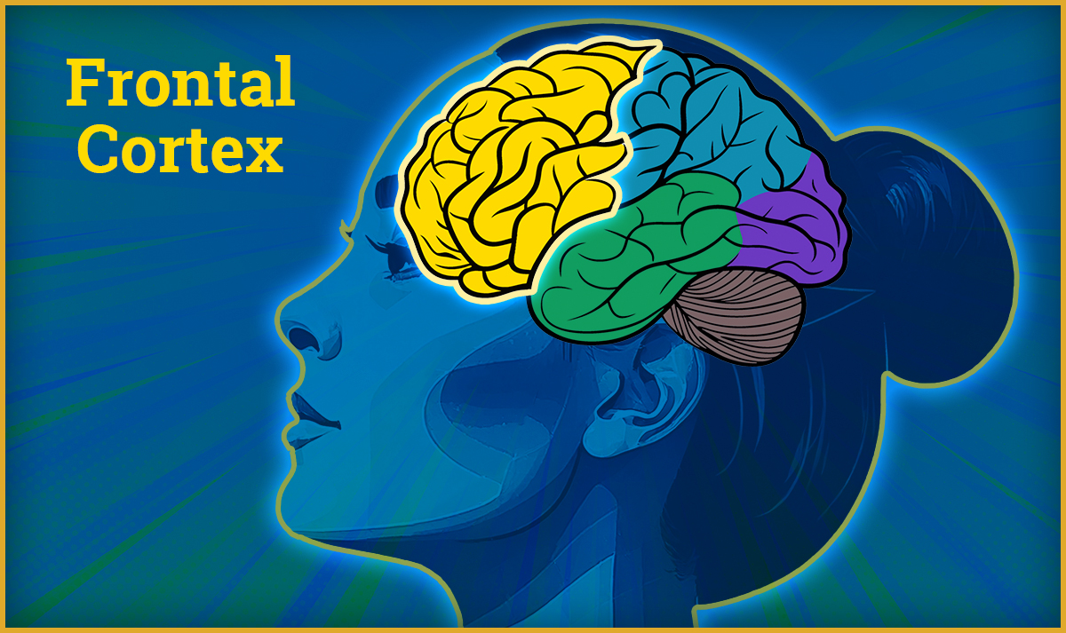
The Frontal Cortex
The frontal cortex:
Regulates stress response
Supports self-awareness
Manages executive functions
Notes:
Facilitator Actions:
Display slide.
Discuss how graphic relates to topic.
Monitor the discussions of the Sailors.
Facilitator Content:
Inform:
The frontal cortex is the most advanced part of our brain and the last to fully mature. The frontal cortex helps us with critical thinking, decision-making, and self-control.
The frontal cortex plays a crucial role in helping us understand what is really happening and directs our behavior accordingly. For example, the frontal cortex can realize that the loud booms you hear come from ceremonial cannons and are not a threat. Similarly, it can recognize that while jumping out of an airplane is inherently dangerous, staying calm and focused is the best way to ensure survival, rather than activating a fight-or-flight response.
The goal of Warrior Toughness is to improve the function of the frontal cortex so that we can perform effectively in high-pressure situations. Through consistent training, we can sharpen the frontal cortex to become faster and stronger when it matters most.
By strengthening the frontal cortex, we can override the automatic amygdala responses when needed, allowing for calmer, deliberate action in stressful or dangerous situations. This is the essence of training in Warrior Toughness; to prepare you to perform at your best when it truly counts.

Slide 7
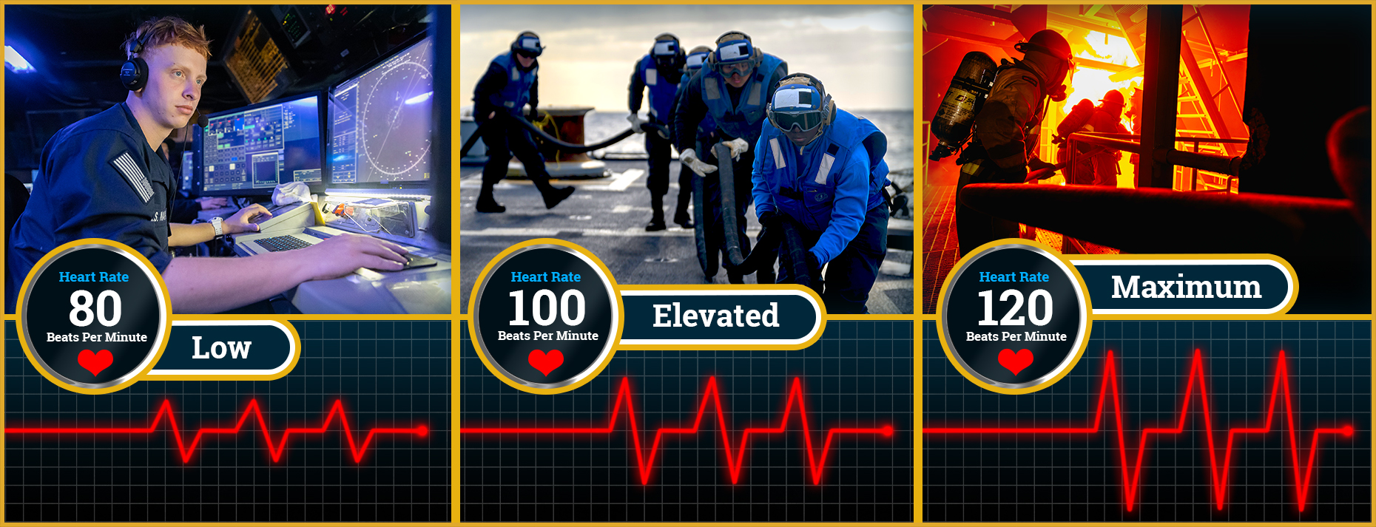
Physiological Activation
Why is a maximum heart rate undesirable in stressful situations?
Notes:
Facilitator Actions:
Display slide.
Discuss how graphics relate to topic.
Monitor the discussions of the Sailors.
Facilitator Content:
Discuss:
Why is a maximum heart rate undesirable in stressful situations?
Inform:
A low heart rate is ideal for situations where calm, focused attention is required, especially in scenarios where movement is not necessary. For example, individuals working in the Combat Information Center (CIC), or those manning the Public Address (PA) system, need to remain steady and composed under pressure without the need for physical action.
A slightly elevated heart rate is more appropriate for fight-or-flight situations where physical action is required. This can include the following tasks:
Bracing for shock
Running to your battle station
Quickly refueling aircraft and loading munitions
Fighting fires or conducting damage control
This elevated state is similar to the feeling of an adrenaline rush, which prepares the body for swift physical movement. However, at this level, fine motor skills such as typing, or speaking eloquently, may be hindered as the body prioritizes larger muscle groups for physical tasks.
A maximum heart rate is undesirable in stressful situations primarily because it impacts our ability to think clearly and act rationally. When the heart rate gets too high, the brain’s cognitive functions are compromised, which leads to:
Reduced decision-making capacity
Impaired judgment
Inability to process multiple stimuli
It is essential to keep stress levels and heart rate at an optimal range to balance focus and awareness, ensuring you can still think critically and act effectively under pressure.

Slide 8

Involuntary Stress Responses
Why do these responses happen?
Involuntary stress responses are part of the mind-body connection that kicks in when preparing your body for survival.
Notes:
Facilitator Actions:
Display slide.
Discuss how graphic relates to topic.
Monitor the discussions of the Sailors.
Facilitator Content:
Inform:
In high-stress, life-or-death situations, some bodily functions may go crazy. It is important to understand that this is normal and part of the body's automatic stress response.
Loss of digestive control, such as spontaneous urination or defecation, is quite common in high-stress environments. Many veterans report only becoming aware they had soiled themselves after a firefight or other intense experience.
It is natural to experience these responses, as long as you can regain your composure and continue to perform your duties. The body’s priority is survival, and warriors who trust in their training can often maintain composure and focus even in these stressful situations.
Why do these responses happen? These reactions are part of the mind-body connection that kicks in when preparing your body for survival.
The body prioritizes the following systems needed for fighting or running:
Increased respiration brings more oxygen into the bloodstream.
An elevated heart rate pumps blood quickly to major muscles.
Blood is diverted to large muscle groups (e.g., legs, arms) necessary for running, fighting, or physical defense.
At the same time, less essential functions, like fine motor skills and the digestive tract, are deprioritized. This explains why tasks like precise hand movements such as typing, or maintaining control over digestion, may become difficult. It is also why people often experience nausea or the feeling of being scared stiff.
Understanding how the body responds under stress helps demystify these involuntary reactions. By keeping yourself composed and focusing on your training, you can manage these natural physiological responses and continue performing your duties effectively.
We can adjust our stress response to meet current day stressors by practicing the following:
Recalibration
Energy management
Mindfulness
Performance statements
Emotional reappraisal

Slide 9
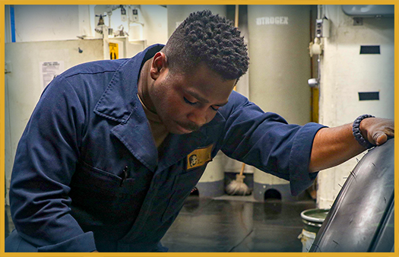
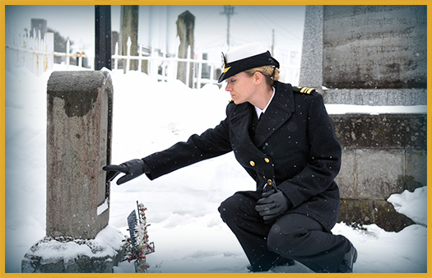
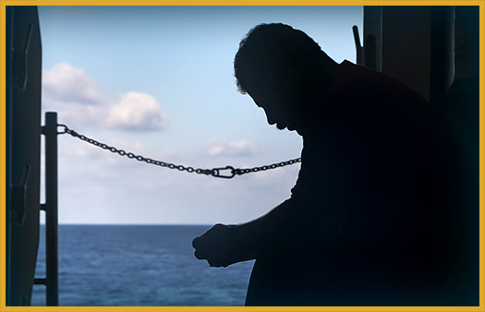
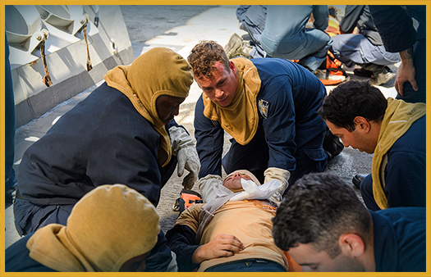
Four Sources of Stress Injury
What are examples of stress injuries?
Use an image of a fatigued Sailor.
Use an image of a Sailor at a graveside.
Use an image of a Sailor alone.
Use an image of a Sailor with a serious injury.
Notes:
Facilitator Actions:
Display slide.
Discuss how graphics relate to topic.
Monitor the discussions of the Sailors.
Facilitator Content:
Discuss:
What are examples of stress injuries?
Inform:
Stress injuries arise from various harmful exposures that can negatively impact a Sailor’s mental and emotional health. While trauma is a well-known cause, there are other significant factors that contribute to a stress injury. It is essential for leaders and peers to recognize these subtle stressors and not focus solely on major traumatic events.
Wear and Tear
Wear and Tear is defined as prolonged exposure to stress, often due to a lack of sufficient sleep, rest, and restoration, and can lead to mental and physical fatigue. This can be from both operational and non-operational stressors. Over time, fatigue weakens the body’s ability to cope with stress, leading to burnout and reduced performance.
Examples of Wear and Tear include the following:
• Accumulation of fatigue due to extended work hours or high operational tempo
• Non-operational stress, such as lack of downtime, insufficient sleep, or chronic overwork
Inner Conflict
Inner Conflict occurs when an individual’s moral or ethical beliefs conflict with their actions or decisions. It can arise from situations where they feel they acted against their values or were unable to prevent harm. Moral injuries can deeply affect a Sailor’s sense of self, leading to guilt, shame, and a breakdown in their ability to cope.
Examples of Inner Conflict include the following:
• Taking action outside of the rules of engagement
• Feeling responsible for harm caused to innocent life
• Experiencing survivor’s guilt
Loss
Loss is a stress injury related to grief or the emotional pain that comes from losing someone close, such as a comrade, leader, or another individual you care about. Loss does not have to be a death but could also be the loss of a sense of identity, loss of a job or position, or loss of opportunity. Loss can lead to feelings of emptiness, isolation, and disconnection, which significantly impacts emotional well-being.
Examples of Loss include the following:
Grief over the death of close comrades during operations
Loss of relationships with friends or family due to deployment, relocation, or other military duties
Life Threat
Life Threat is a source of stress injury that arises from exposure to life-threatening situations that provoke feelings of terror, horror, or helplessness. Life-threatening situations can cause long-term psychological trauma, including post-traumatic stress and heightened anxiety.
Examples of Life Threat include the following:
• Witnessing death or injury during combat or operations
• Experiencing helplessness in the face of traumatic events
• Being involved in or witnessing a traumatic life event
Each of these sources of stress injury can deeply affect Sailors in different ways. It is important for leaders and peers to recognize these diverse stressors and not just focus on overt trauma. By understanding the full scope of stress injuries, we can better support individuals in addressing and mitigating their effects, ensuring recovery and resilience.

Slide 10
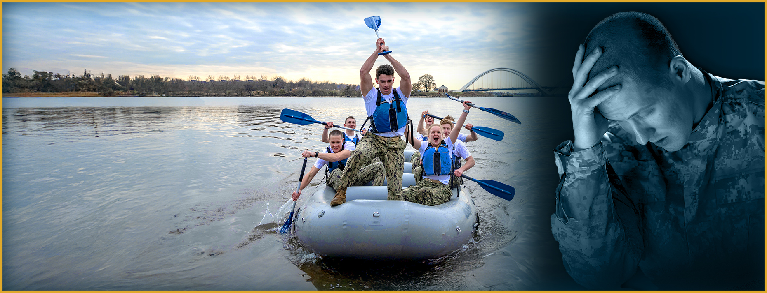
Eustress Versus Distress
How have stressful experiences from the past made you stronger and more resilient today?
Eustress motivates
and energizes.
Distress overwhelms
and harms.
The key is to develop a balanced, positive relationship with stress, learning how to use it for growth without letting it control us.
Notes:
Facilitator Actions:
Display slide.
Discuss how graphic relates to topic.
Monitor the discussions of the Sailors.
Facilitator Content:
Inform:
Stress has the power to push us to grow, improve, and motivate us toward achieving our goals. When we have a healthy relationship with stress, it can be a valuable ally in helping us perform at our best. However, if we do not nurture and manage our relationship with stress, it can become toxic. We do not want to let stress overwhelm us and harm our well-being.
Defining features of eustress include:
A desire for movement that can motivate a person, pushing them forward toward growth
Positive energy that can be used to achieve optimal performance
A sense of excitement
A time and space for recovery
Defining features of distress include:
Feeling overwhelmed or beyond the resources and thus demotivating an individual from moving forward
Feeling energy drained or difficult to control thus decreasing performance
Experiencing exhaustion
Feeling of having no chance for recovery
Discuss:
• How have stressful experiences from the past made you stronger and more resilient today?
Reflect on personal experiences where stress led to growth, learning, or overcoming challenges. Consider how these moments have shaped your ability to handle stress now.
• How can changing your perception of stress help you deal with it more effectively?
Inform:
The key is to develop a balanced, positive relationship with stress, learning how to use it for growth without letting it control us.

Slide 11


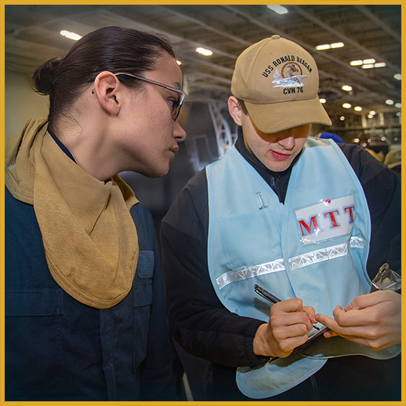
Stress Is Necessary
Why is stress necessary?
Stress acts as a signal. Stress alerts us that something requires our attention.
Notes:
Facilitator Actions:
Display slide.
Discuss how graphics relate to topic.
Monitor the discussions of the Sailors.
Facilitator Content:
Discuss:
Why is stress necessary?
Inform:
The role of stress is to:
Act as a signal. Stress alerts us that something requires our attention.
Motivate us. Stress can push us to take action and achieve our goals.
Help us learn. By navigating stressful situations, we develop strategies that help us grow and perform better in the future.
Stress is neither inherently good nor bad. It can be helpful in some situations and unhelpful in others. What matters is the level of stress; too little or too much can negatively impact performance and hinder our ability to meet goals. We need some level of stress in our everyday lives to function optimally. Stress is essential for:
Optimal performance: The right amount of stress helps you focus and perform at your best.
Strength and toughness: Stress builds resilience, making us stronger over time.
Growth and development: Navigating stress helps us develop new skills.
Meeting challenges: It prepares us to face and overcome difficult situations.
Performing difficult missions: In high-pressure environments such as in the military, stress sharpens our ability to execute complex tasks.
Getting to the green zone: If you are in the blue zone (disengaged or unmotivated), stress can help stimulate focus and action.
Stress and the Military
A career in the military is bound to be stressful. Resilience is essential for Sailors to survive threats and accomplish missions. Through resilience, Sailors can adapt well to these experiences over time. Examples of military demands that cause stress include:
Maintaining a forward presence
Increasing work demands with decreasing staff
Adapting leader or management styles
Addressing career concerns

Slide 12
Success Requires Stress
Optimal Performance
Under Performance
EUSTRESS
Point of Concern
Performance
Impaired Performance
Not Engaged
Distress
Ready/Engaged
Stress Level
Challenge
Support
Notes:
Facilitator Actions:
Display slide.
Discuss how graphic relates to topic.
Monitor the discussions of the Sailors.
Facilitator Content:
Discuss:
Can you think of a time when stress motivated you to perform at an optimal level? Examples may include taking a test or completing Physical Training (PT).
How do you measure your own motivation and optimal performance?
What interferes with your optimal performance?
Inform:
The Role of Stress in Performance
Stress is necessary for success and optimal performance. When managed well, it pushes us to meet challenges, grow, and achieve our goals. However, when stress becomes overwhelming or prolonged, it can hinder performance and lead to negative outcomes. The key is finding the right balance of stress to stay motivated and productive while avoiding the risks of burnout.
The Yerkes-Dodson Law: Stress and Performance
The Yerkes-Dodson Law describes the relationship between arousal (stress) and performance. Originally developed by psychologists, Robert M. Yerkes and John Dillingham Dodson in 1908, this law shows that performance increases with arousal up to a certain point, but beyond that point, performance decreases. This relationship is often visualized as a bell-shaped curve, where:
Low stress results in under performance.
Moderate stress leads to optimal performance.
High stress results in impaired performance.

Slide 13
The Five Zones of the Expanded Stress Continuum
Awareness helps Sailors seek support early.
Not Engaged | Ready | Reacting | Injured | Ill
Disinterested Unmotivated Unfocused No initiative Unproductive Limited involvement in work relationships | Good to go Well trained Fit and focused Connected Accepting new challenges Active coping Effectively Manages stress | Quick temper Irritable Diminished self-control Poor focus Poor sleep Temporary & transitory Needed for growth Withdrawing from usual social activities | Serious or significant distress or impairment due to: W.I.L.T. (i.e., Wear & Tear, Inner Conflict, Loss, & Life Threat) Overwhelming emotions Insomnia, nightmares Breaking relationships Shame, guilt Destructive behavior | Stress injuries that don’t heal without help Diagnosable mental health and substance use disorders
LEADERSHIP OPPORTUNITY | OPTIMAL PERFORMANCE | SELF-CARE OPPORTUNITY | POINT OF INTERVENTION | RECOVERS WITH EFFECTIVE CARE & REINTEGRATION
Unit Leader Responsibility |  | Individual, Shipmate, Family Responsibility |  | Caregiver Responsibility
NOT ENGAGED
READY
REACTING
INJURED
ILL
Notes:
Facilitator Actions:
Display slide.
Discuss how graphic relates to topic.
Monitor the discussions of the Sailors.
Facilitator Content:
Inform:
The Expanded Stress Continuum is an evolved version of the original Stress Continuum Model (SCM) developed by the Navy and Marine Corps. It remains an evidence-based and evidence-informed model aligned with military culture. The continuum helps establish a standardized language that Sailors can use to identify and describe their stress responses.
This model categorizes stress responses into five zones, each representing different levels of stress. It serves as both a tool and a common language to identify, engage, and intervene when stress reactions or injuries are present. The goal is to facilitate conversations about asking for help and offering support when needed.
Blue “Not Engaged” Zone: Leadership Opportunity
The blue zone represents an opportunity for leadership and peers to engage Sailors who may show perpetual substandard performance or a general lack of engagement.
Sailors in this zone are often physically and psychologically healthy but may lack motivation or purpose. They experience minimal stress, but the absence of stressors may lead to disengagement.
Leaders should identify the motives for non-engagement and begin the process of mitigating or managing the underlying issues. The goal is to reintegrate the Sailor into the green zone.
Green “Ready” Zone: Optimal Performance
The green zone signifies optimal performance where Sailors are fully engaged, using adaptive coping mechanisms to handle stress effectively.
Sailors in the green zone are physically and mentally healthy, operating at their best.
Key Concept: This is where Sailor’s experience optimal readiness and can perform at their highest level.
Yellow “Reacting” Zone: Self-Care Opportunity
The yellow zone reflects mild to moderate stress that is temporary and reversible. Sailors may experience increased stress, but the situation is manageable with self-care strategies.
Key Concept: This is a self-care opportunity, Sailors can recognize their stress and take action to return to the green zone through activities such as rest, relaxation, or mindfulness.
Orange “Injured” Zone: Point of Intervention
The orange zone represents serious or significant stress that results in distress, impairment, or a loss of function. This is where stress begins to interfere with daily life and performance.
Key Concept: This is the point of intervention where leaders and peers must step in to provide support or resources to prevent further deterioration.
Red “Ill” Zone: Recovers With Effective Care and Reintegration
The red zone is characterized by medical disorders that arise from unmitigated stress or unhealed stress injuries. Individuals in this zone require professional medical care.
Key Concept: With effective care and support, Sailors in the red zone can recover and reintegrate into a healthier state of being.

Slide 14
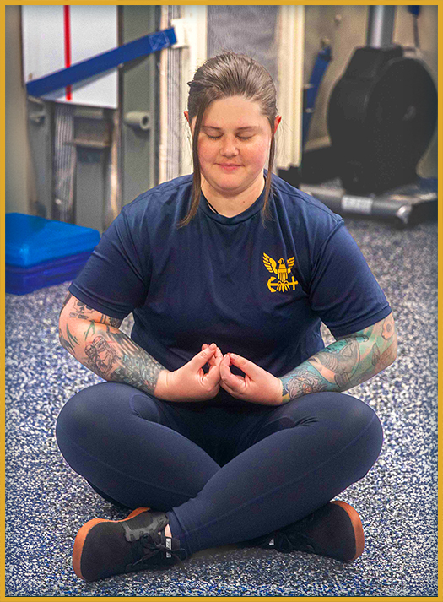
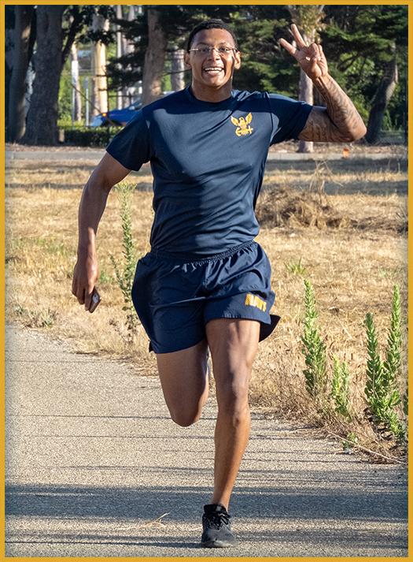

The Consequences of Chronic Stress
How does long-term stress affect you in the three domains: Mind, Body, Spirit?
Notes:
Facilitator Actions:
Display slide.
Discuss how graphics relate to topic.
Monitor the discussions of the Sailors.
Facilitator Content:
Discuss:
How does long-term stress affect you in the three domains: Mind, Body, Spirit?
Encourage Sailors to think about how stress manifests in these areas of their lives.
Inform:
The Impact of Long-Term Stress
When stress becomes chronic, the body is exposed to elevated levels of cortisol and other stress hormones for extended periods. This can lead to serious consequences, affecting multiple areas of life. Prolonged stress compromises the immune system, reducing the body’s ability to recover and defend against illness. Stress becomes problematic when it is persistent.
Stress becomes chronic when:
It exceeds our belief in our ability to cope.
It is unrelenting, leaving no time for recovery or relief.
It feeds into a cycle, where we start stressing about being stressed, compounding the issue.
The effects of long-term stress on the Mind include:
Memory loss
Loss of interest
Trouble thinking clearly
Distrust
Racing thought
Loneliness or anger
Loss of motivation
Nervousness and anxiousness
The effects of long-term stress on the Body include:
Crying
Overeating, excessive smoking, or drug use
Overuse of alcohol
Low energy
Headaches
Indigestion or stomach aches
Sleep difficulties
The effects of long-term stress on the Spirit include:
Loss of direction
Loss of meaning and purpose
Doubt
Change in values
Change in religious beliefs or spirituality
Disconnection
Isolation or loneliness
Distrust
Chronic stress, if left unchecked, can take a toll on every aspect of our lives: mentally, physically, and spiritually. Recognizing the signs of long-term stress and taking steps to manage and mitigate it is essential to maintain overall well-being.

Slide 15
Recovery and Performance
What is the difference between these two individuals?
Baseline
Performance
Ready
Recovery
Recovery
Recovery
Reacting
PERFORMANCE
Injured
Ill
Stressor
Stressor
Stressor
TIME
Notes:
Facilitator Actions:
Display slide.
Discuss how graphic relates to topic.
Monitor the discussions of the Sailors.
Facilitator Content:
Discuss:
What is the difference between these two individuals?
Inform:
One individual is able to manage stress well, with their arousal levels returning to normal after the stressor is dealt with.
The other individual struggles with overwhelming and chronic stress, where the arousal reaction continues even after the stressor is resolved, leading to an elevated baseline of stress over time.
Individual Vulnerability to Stress
Everyone has a different level of vulnerability to stress, which is influenced by several factors. Some of these factors are inborn and unchangeable, while others can be modified through training and skill development. Key factors that influence vulnerability include:
Biology and genetics
Some individuals may be genetically predisposed to handle stress better or worse than others.
Attitude and beliefs toward stress
How a person perceives stress can significantly impact how they respond to it. Viewing stress as a challenge rather than a threat can foster resilience.
Life experiences and environmental circumstances
Past experiences, including trauma or exposure to stressful environments, can affect how someone deals with future stressors.
Psychological and physical characteristics
Factors like personality traits and physical fitness can affect stress vulnerability.
Family, social support, and community connections
Strong social ties and community support can buffer the effects of stress.
Building Resilience: The Role of Coping Skills
While certain factors like genetics and past life experiences cannot be modified, individuals can be taught new resiliency skills to better manage stress and become more resilient over time.
Even individuals who are less susceptible to stress, those who require higher levels of stress to trigger a negative reaction, are not immune to it. Everyone can benefit from practicing coping skills, as stress affects all people at some point.

Slide 16
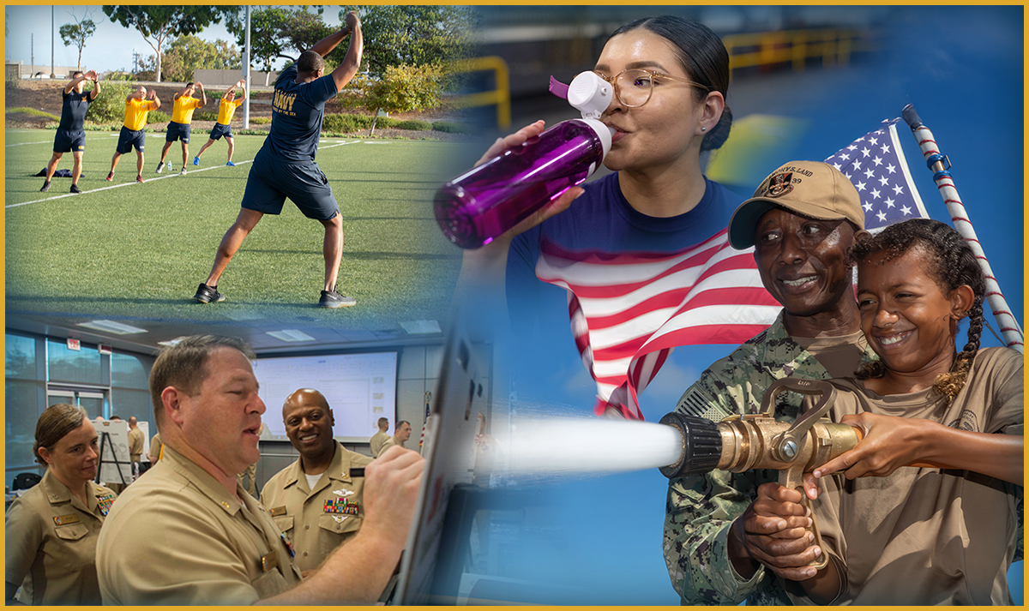
Build Your Resilience
Which of these skills have you incorporated into your daily life?
These skills include:
Mindfulness
Valued living
Flexible thinking
Healthy behaviors
Problem solving
Create a collage that represents three skills:
Valued living – Sailor or civilian attending their child’s school play, or sporting event
Healthy behaviors – military team prioritizing hydration, stretching, and sleep; or civilian in similar situation
Problem solving – military team gathered around a white board, brainstorming solutions; or civilian putting the last puzzle piece in place
Notes:
Facilitator Actions:
Display slide.
Discuss how graphic relates to topic.
Monitor the discussions of the Sailors.
Facilitator Content:
Inform:
When practiced daily and regularly, these skills can help you:
Focus and perform under pressure.
Maintain adequate control over emotions.
Use good judgment.
Overcome setbacks.
Promote healthy relationships.
Support mature and responsible behavior.
Cope with stress.
Solve problems.
Make good decisions.
Discuss:
Which of these skills have you incorporated into your daily life?

Slide 17
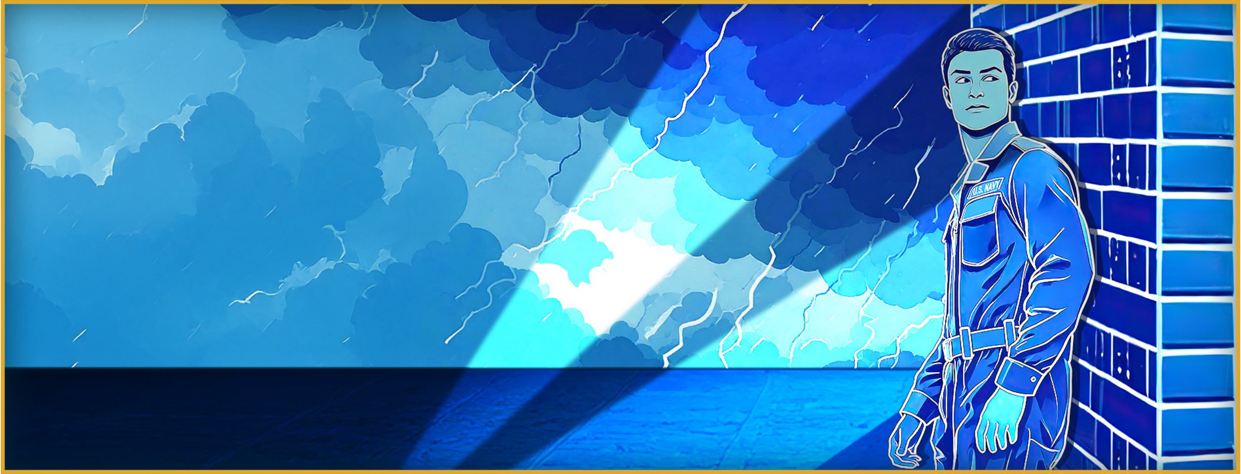
Break the Code of Silence
What is keeping you from getting the help you need?
Stigma
Trust
Time and Energy
Lack of Understanding
Lack of Support
Fear of Reprisal
Access
Communication
B
A
R
R
I
E
R
S
Notes:
Facilitator Actions:
Display slide.
Discuss how graphic relates to topic.
Monitor the discussions of the Sailors.
Facilitator Content:
Discuss:
What is keeping you from getting the help you need?
What are some other barriers you can think of that prevent individuals from seeking help?
Inform:
Our goal is to normalize the process of seeking and asking for help. Breaking the code of silence enforces that it is okay to ask for help during times of distress. Individuals cannot keep things bottled up, because eventually that energy will be released and can be damaging if not dealt with properly.
Any illness or injury can and will get worse before it gets better without proper guidance or assistance. It is about knowing the signs and symptoms, creating a safe environment and a positive culture that supports Sailors in asking for help and making it okay to intervene and engage.
Any one of these barriers can delay or prevent individuals from getting the appropriate care they need.
Stigma
A common barrier to seeking treatment is the perceived stigma of asking for help. Sailors often struggle to move beyond thoughts such as:
I will be seen as weak.
Peers might have less confidence in me.
Leaders will blame me for problems.
It would be too embarrassing for my family.
Reduce misconceptions or stigma connected with seeking help for stress injuries. Learn to get comfortable interacting with peers and create a safe place to get help.
Trust
It is difficult to reveal personal details to another individual or leader. Many worry that their personal information will not be kept confidential and that their information could negatively impact their military career.
To connect Sailors with services or recourses, it is important to build trust among peers to get them to a relaxed state where they feel comfortable discussing life stressors.
Time and Energy
Many of us are so exhausted and overwhelmed by the demands of work and emotional stressors that we feel we have neither the time nor the energy to seek help or talk to someone. Consider doing the following:
Schedule it into your day, like you do for work meetings, and appointments.
Reevaluate your priorities.
Cancel other activities.
Lack of Understanding and Support by Leadership
Many lack an understanding of mental illness and because of this may not think they need help. Individuals dismiss or minimize their issues and say, “everyone gets stressed out”, or “my problems are not that bad.”
Fear of Reprisal
Many Sailors are afraid to take the critical steps to get help because they believe it might reflect badly on their character or have negative repercussions for doing so.
Access
Even if someone is interested in getting help, many believe they have limited access to care or are unaware of how to get it.
Communication (Lack of Communication)
The more we talk about getting help, the less stigma and fear our Sailors will experience in seeking assistance.

Slide 18
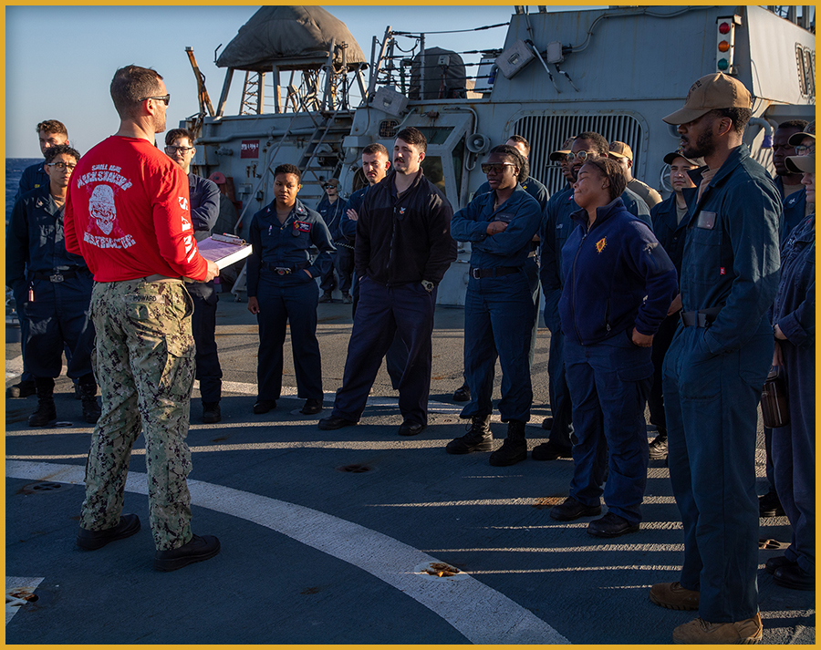
Activity
What are some examples of stressors Sailors might face in their roles?
How can you recognize when stress is becoming harmful to yourself or others?
Describe a situation where stress might be positive and how you would harness it.
What are some practical ways to mitigate negative stress in high-pressure situations?
Notes:
Facilitator Actions:
Display slide.
Monitor the discussions of the Sailors.
Allotted time for activity: 10 minutes.
Facilitator Content:
Expected outcomes: Sailors will deepen their understanding of stress, distinguish between positive and negative types, and collaborate to apply practical stress management strategies to real-world scenarios.
Perform:
Divide the Sailors into pairs.
Prompt Sailors to read the questions related to the Understanding Stress content.
Each pair discusses and writes down their responses.
Emphasize that answers should connect to their personal experiences or work context.
Bring Sailors back to share their answers.
Select pairs to present their thoughts for each question.
Encourage others to add additional insights or examples.

Slide 19

Strengthen Warrior Toughness by understanding stress!
Call to Action
Notes:
Facilitator Actions:
Display slide.
Review topics discussed and ask if there are any questions.
Check Sailor comprehension by providing review questions and/or problems.
Discuss how the call to action supports and encourages Sailors’ post training.
Relate call to action to Warrior Toughness.
Facilitator Content: N/A

Slide 20
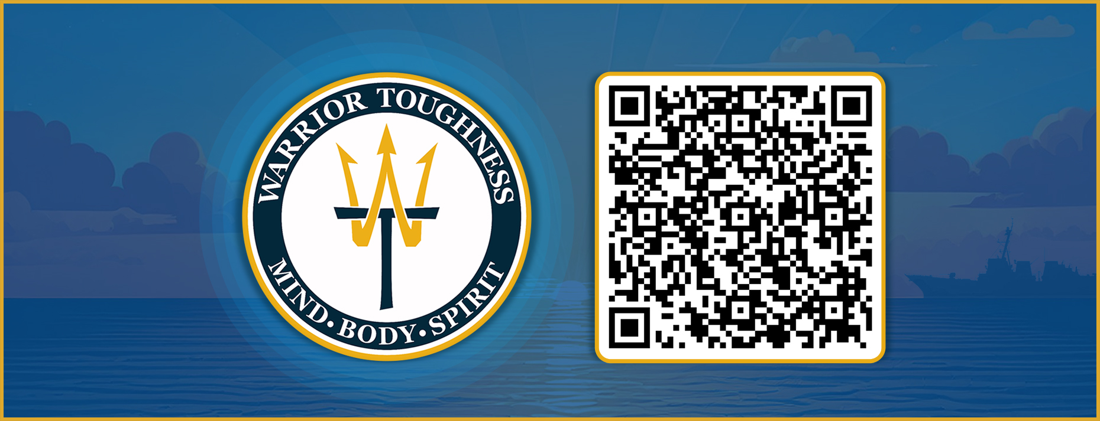
Warrior Toughness QR Code
Notes:
Facilitator Actions:
Display slide.
Facilitator Content:
Inform:
Identify Warrior Toughness QR code.

Slide 21
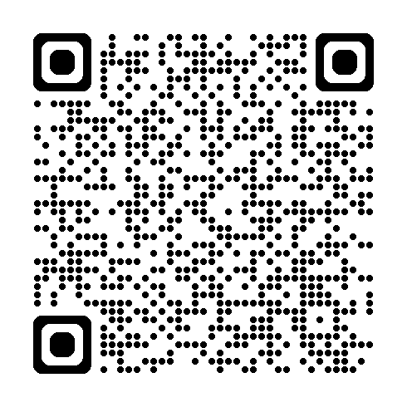
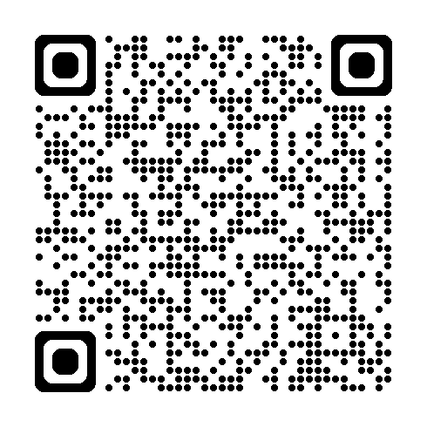
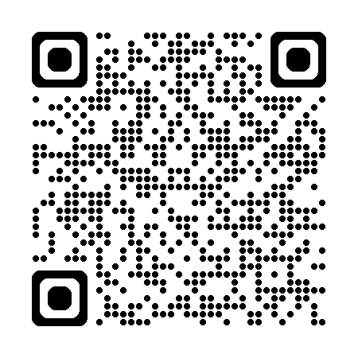
References
Tools and Resources
"Managing Deployment Stress and How to Prepare.” Educational podcast. 24:00.
Stress-o-Meter Infographic & Stress-o-Meter webpage
TED. “How to make stress your friend.” Educational video, 14:28.
Notes:
Facilitator Actions:
Display slide.
Facilitator Content:
Inform:
Identify tools.
Identify resources.

Slide 22
Glossary
Glossary
Acronym | Term
CIC | Combat Information Center
PA | Public Address
PT | Physical Training
SCM | Stress Continuum Model
W.I.L.T. | Wear & Tear, Inner Conflict, Loss, & Life Threat
WT | Warrior Toughness
Notes:
Facilitator Actions:
Display slide.
Facilitator Content: N/A

